Slide 1
Capstone Project – The Battle of London Neighbourhoods
Sin Wee Lee

Slide 2
Objectives
This project aims to address this by carried out a comparative study on the facilities and amenities between the two boroughs with the highest income rate and the lowest in London.

Slide 3
Questions to answer
What types of facilities (venues) and amenities are available in the area with different poverty line?
How venues changing based on the spending power?
What are the distinctive venues that represent in these boroughs
By answering the above questions, the findings can be used for the targeting development for the rest of the London Boroughs so that unnecessary development can be avoided and overall budget can be sustained.

Slide 4
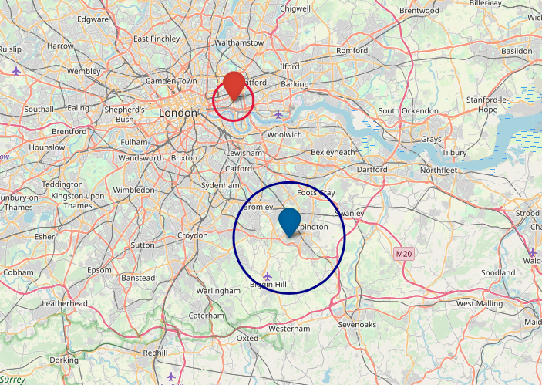
Boroughs Locations

Slide 5
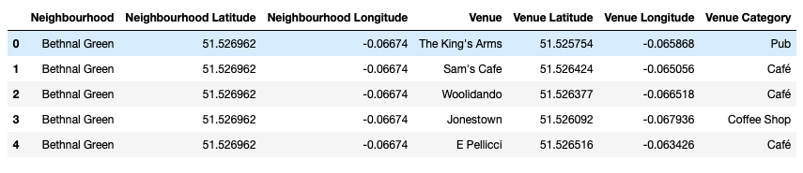
Data Generations
Tower Hamlet:

Slide 6
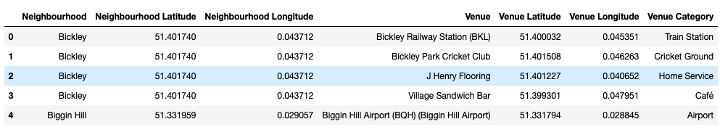
Data Generations
Using the data, we successfully retrieved the following:
Total venues in Tower Hamlet neighbourhoods returned by Foursquare: 520
Total venues in Bromley neighbourhoods returned by Foursquare: 193
Total unique venue categories in Tower Hamlet = 156
Total unique venue categories in Bromley = 76

Slide 7
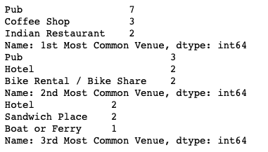
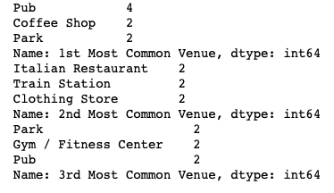
Analysis of Results and Discussions: Most Common Venues
Tower Hamlet
Bromley

Slide 8
Analysis of results
Tower Hamlet: referring to the first 3 most common venues in Tower Hamlet, we can easily identify that most venues are food and beverage venues, with 84% of the venues. It is seeming that in most of the Tower Hamlet venues are for essential sustenance providers. Furthermore, due to the location of the borough, the boroughs have provided bike rental and bike share venues for the residents to commute within the area.
Bromley: However, in Bromley, although also includes food and beverage venues, the venues also includes clothing stores, gyms, parks and Italian restaurants, as such that these are life style luxuries that are mostly common for area that have low poverty rates.
Majority of the venues in Tower Hamlets are food and beverage or sustenance venues, such as cafe, pubs restaurant, grocery stores etc. However,
Bromley provides more lifestyle venues such as Gyms, massage studios, health and beauty studio, golf course, theatre and garden centre just to name a few.

Slide 9
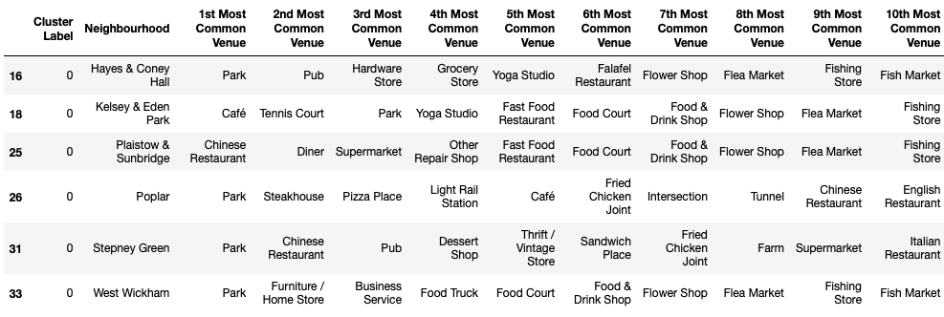
Clustering Analysis: Cluster 1

Slide 10
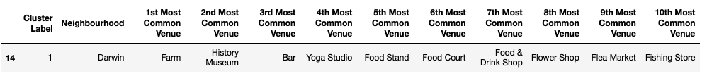
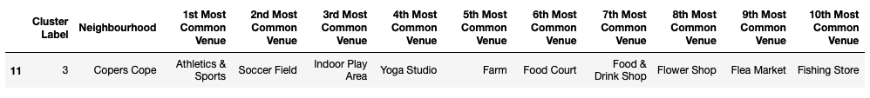
Clustering Analysis: Cluster 2 & 4

Slide 11
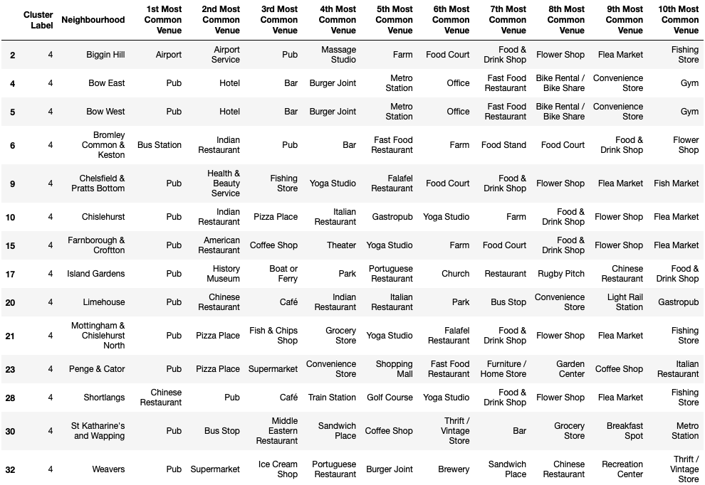
Clustering Analysis: Cluster 5

Slide 12
Conclusions
In conclusion, based on the poverty rate, we can clearly see there are discrepancies in terms of the venues at each borough. At Tower Hamlet, it is clearly shown that most venues provided are essential venues for day-to-day life as in Bromley, much of the venues are lifestyle venues and required certain level of incomes.

